Slide 1
Group 20 Level 4-5
Ross Warren (s176778)
Max Carter (s175573)
Jack Fuller (s176802)
Jake Seaman (s183883)

Slide 2

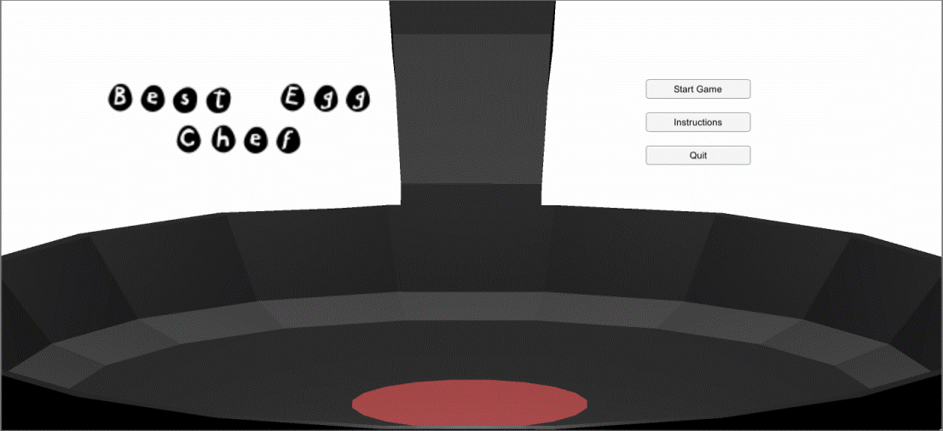

Sunny Slide Up
Tagline – Princess Layer is busy laying eggs. As her apostles, it’s your job to bounce eggs into your basket to send the eggs down to her people.
Platforms – iOS & Android.

Slide 3
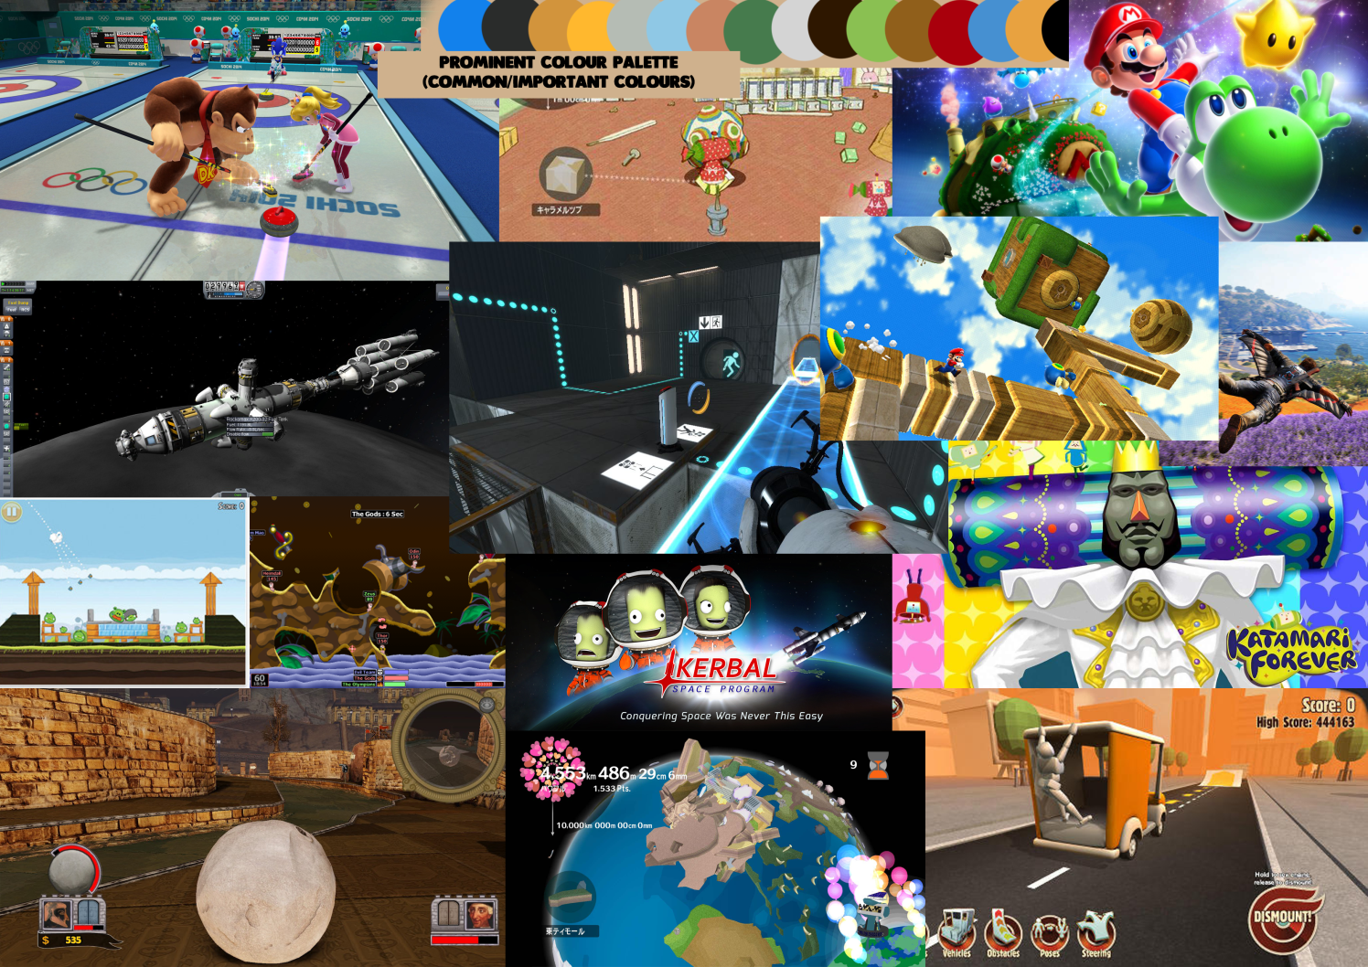
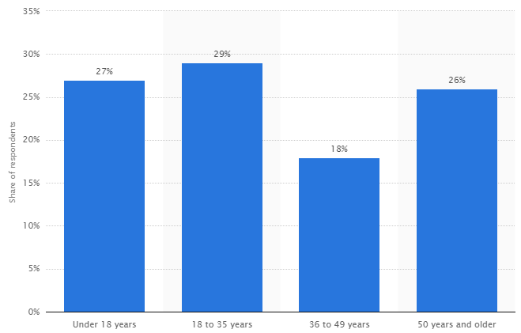
Research
Age and gender.
Similar games to establish a chosen art style.
Mechanics.
https://www.statista.com/statistics/189582/age-of-us-video-game-players-since-2010/
Notes:
Within the development of sunny slide up, we had to develop the aesthetics of our game, in a way that they can relate to the chosen target audience, this required establishing the target audience through reliable sources such as statista.com’s analytics on the ages of gamers and how many of each age make up the gaming audience.
We also researched into games of similar physics based mechanics compared to our concepts of design, to spot any coherent theme and what design choices were justified for us to use. Looking at these games we established our game will use mainly, blues, greens and oranges with a rounded art style, keeping all assets very round and outlined clearly to have a simply yet stand out style.
The round art style will help to keep the player engaged on the gameplay, but not distracted by overcomplicated assets.

Slide 4


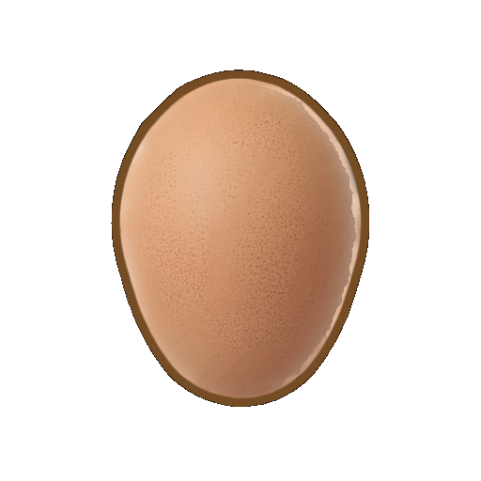
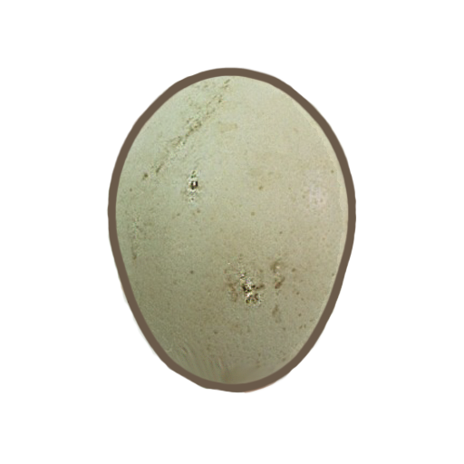


Mechanics
Bouncing.
Catching/Avoiding.
Scoring.
Notes:
The mechanics in SSU use elements of unpredictability from various bouncing eggs that you as the players bounce off your characters whilst avoiding other potentially harmful eggs. This all will contribute towards a scoring system that determins the winner of the game. Lets talk more about these mechanics and why we have chosen them.
*Talk about our design choices*
Bouncing – The bouncing within Sunny Slide Up helps promote unpredictability as the physics of the eggs send them bouncing around making a chaotic yet fun game enviroment.
Catching – The catching creates an element of skill required for the game, this
Avoiding –
The whole game revolves around a scoring system. Different types of eggs offer different amounts of points.
Scoring -

Slide 5

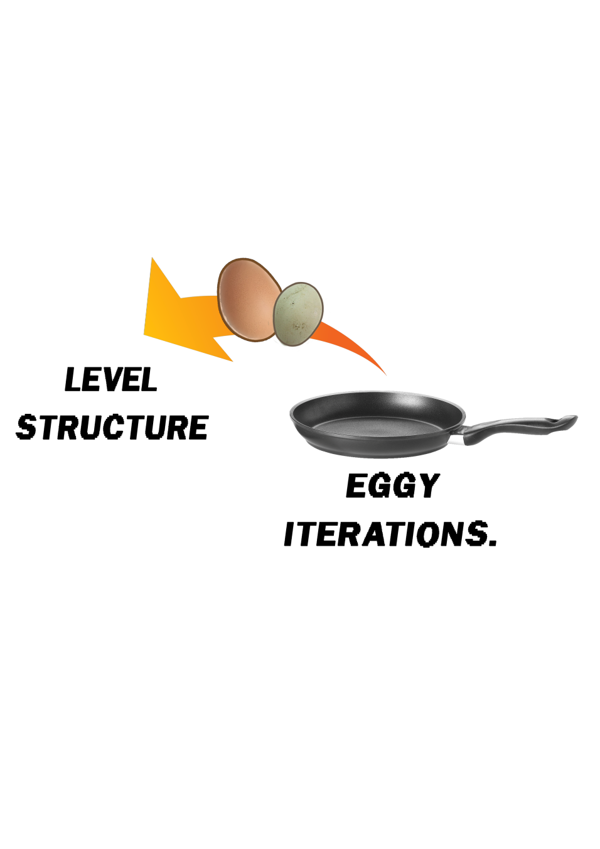
Level Structure
Based on a sequence of 5 levels.
Level calls random stage of set difficulty.
Difficulty scales with level number.

Slide 6
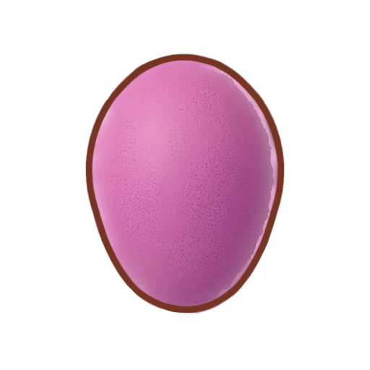
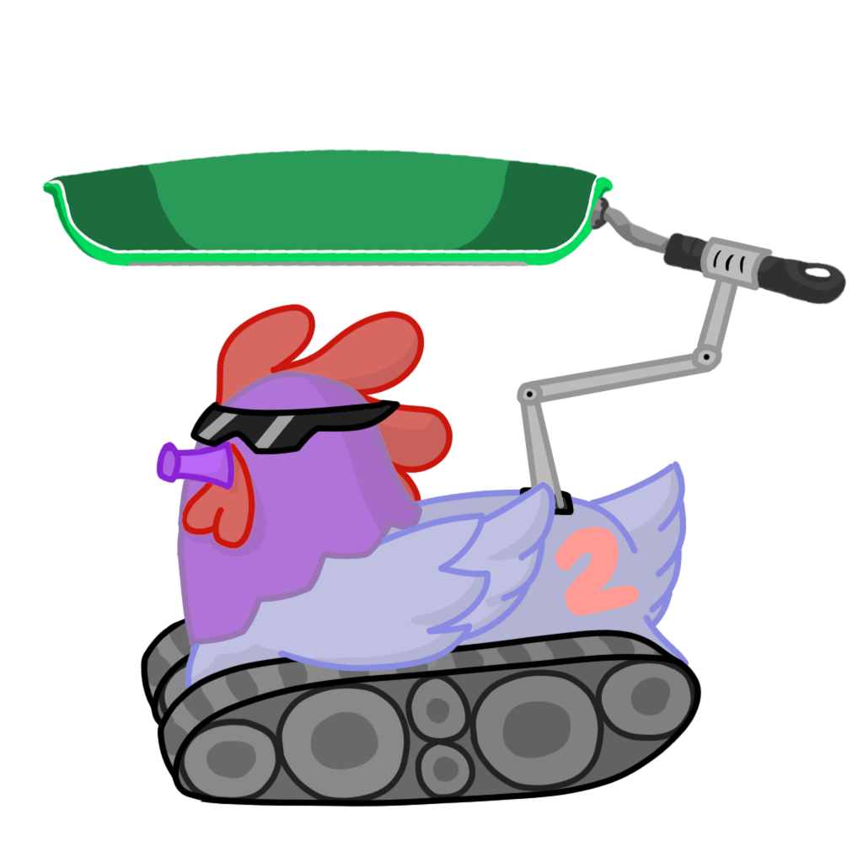

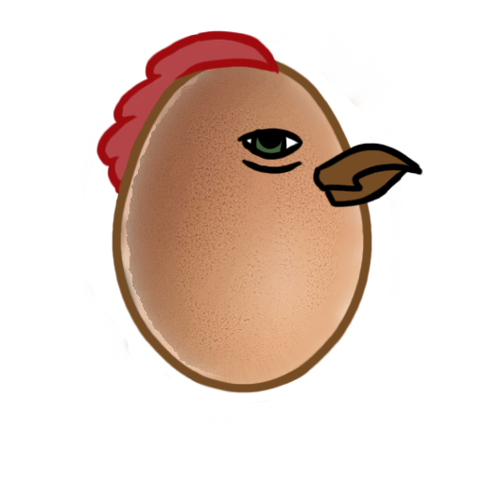

Art Showcase
Notes:
We will now move on to the game showcase, we will show you a small segment of sunny slide ups gameplay.

Slide 7
Game Showcase

Slide 8


Added features
Rewards (replayability).
High Scores.
Trophies.
Notes:
With the full release of sunny slide up. Some extra features that are in development will be added, these are ways of rewarding the player and keeping audiences invested. Some of these are high scores.
High scores encourage players to come back and beat there peers score, through research into how to create replay value in our game we selected high scores and trophies as our main method of replay attraction.
Trophies will provide a reward system towards the players, this will contain certain goals that players can overcome and receive a small in game trophy and praise for it that will encourage a player to collect them all.

Slide 9
Playtesting and results
Notes:
Through our playtesting we have Fierro, laughter, disappointment and even frustration. The results of our consecutive playtesting through iterations of our game has helped to structure a chaotic yet understandable and enjoyable mechanic, from early points in development playtesting has helped us to structure a balance in our gameplay that brings unpredictability and skill together.
Some things we found with our playtesting was that unless there was enough variation in our levels and game itself the players would not stick around and continue to play, this helped us to develop things that we could use to counter that such as our five level structure.
We believe that our playtesting is the backbone of our game and creates a structure of which we build our mechanics and aesthetics onto.

Slide 10
Emails and Jira
Total Emails Sent: Max – 145 Ross – 74 Jack – 58 Jake – 55
Approximate Hours Logged: (Total 169h 40m)
Max – 55 hours Ross – 53 hours Jack – 30 hours Jake – 37 hours

Slide 11
Questions?

